Slide 1


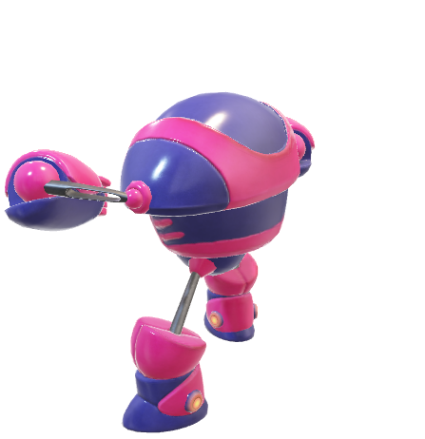
MINI PROJECT SEMINOR ON
CLOUD COMPUTING SECURE KEYWORD SEARCH AND DATA SHARING
Department of Computer science and Engineering(AI & ML)
Presented by …
Muthyam Pranavi (22TR1A6639)
Nagunuri Deekshitha(22TR1A6640)
Harikesha Pathuri (22TR1A6645)
Marri Yaswanth(22TR1A6634)
Under the Guidance of…
K.SIREESHA
Asst Professor

Slide 2

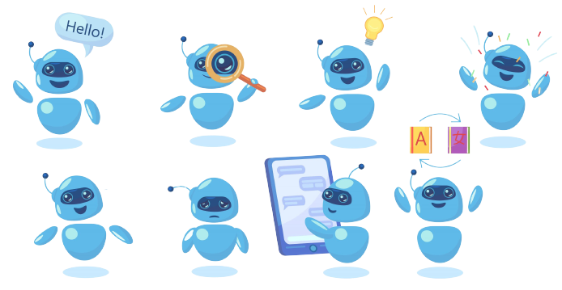
Agenda
Introduction
Why Secure Keyword Search?
Existing System
Proposed System
System Architecture
Data Flow Diagram
UML Diagram
Implementation Modules
Advantages
Conclusion

Slide 3

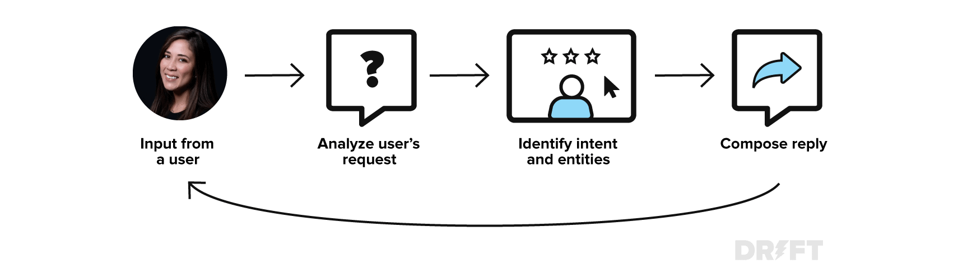
Agenda
Introduction
What Exactly Is an AI Chatbot?
Cloud computing allows data outsourcing with low cost and ease.
Major challenges: Ensuring data security and privacy.
Attribute-Based Encryption(ABE) secures data but lacks support for keyword search and sharing.
Real-world need: Search and share encrypted data without decryption.
Benefits of AI Chatbots
Types of AI Chatbots
Chatbots available on Internet
Prompt Engineering
Challenges and Limitations
A Case Study
Ethical Considerations
Conclusion

Slide 4
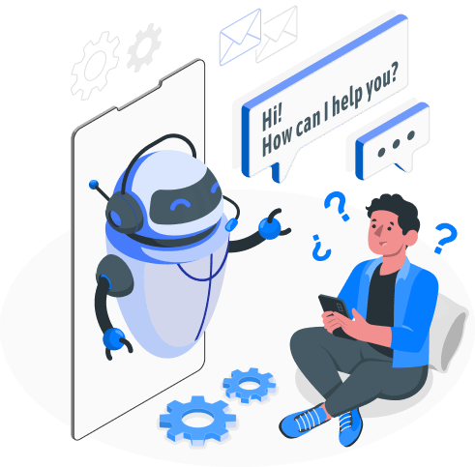
Introduction
Why Secure Keyword Search?
An AI Chatbot can perform tasks beyond the human capabilities.
Searching encrypted data directly is not supported in traditional ABE.
Example: A doctor must decrypt all records to search by
keyword.
This process is inefficient and privacy-invasive.
Need for keyword search on encrypted data.
Benefits of AI Chatbots
Types of AI Chatbots
Enhance customer service and automate interactions.
Chatbots available on Internet
Challenges and Limitations
Convenient, helpful, interactive, virtual assistant.
A Case Study
Ethical Considerations
Conclusion

Slide 5


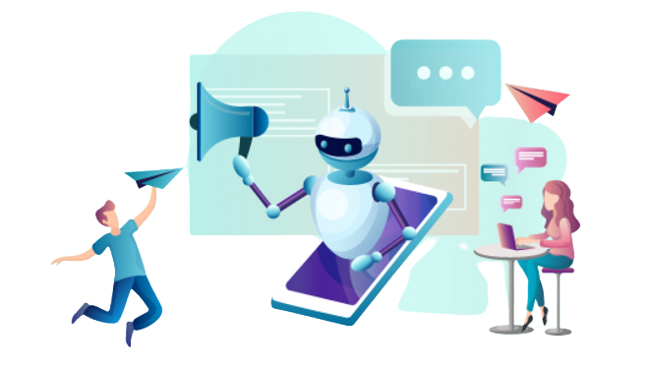




What Exactly Is an AI Chatbot?
Existing System
Content Generation Chatbots
Image Generation Chatbots
Uses Attribute-Based Encryption(ABE).
Types: KP-ABE and CP-ABE.
Types of AI Chatbots
Issues:
Long ciphertexts
No keyword search
No keyword updates
Code Generation Chatbots
Art Generative Chatbots
An automated conversation using artificial intelligence.
Chatbots available on Internet
Challenges and Limitations
These chatbots are designed to simulate human-like interactions.
Music Generation Chatbots
Video Generation Chatbots
Outsourced decryption is risky.
A Case Study
Proxy Re-Encryption(PRE) added but lacks privacy in search.
Processes input, generates relevant responses.
Ethical Considerations
Conclusion

Slide 6

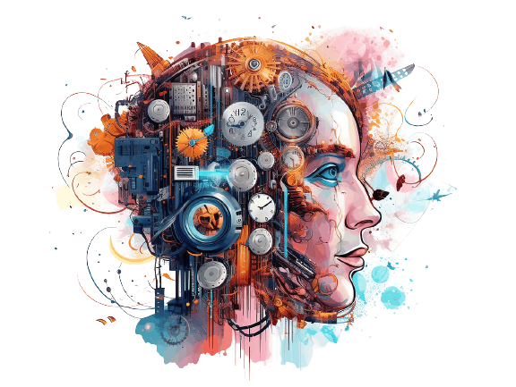
AI chatbots are economically friendly.
Wordtune: Summarizes the notes
Benefits of AI Chatbots
Chatbots respond to users’ queries instantly.
Soundraw: Generates music
Proposed System
Introduces CPAB-KSDS: Ciphertext-Policy Attribute-Based Encryption with Keyword Search and Data Sharing.
Enables encrypted search and secure sharing.
Supports keyword updates.
Does not require a Public Key Generator(PKG).
Replit: Generate codes
Remove.bg: Remove background in images
Chatbots available on Internet
Automation reduces the likelihood of human errors.
Challenges and Limitations
A Case Study
Ethical Considerations
Conclusion
Midjourney: Generates art
ChatGPT: Solves anything
Writesonic: Writes anything
24/7 Availability.
Has Infinite amount of patience.
SlidesAI: Generate PPTs

Slide 7

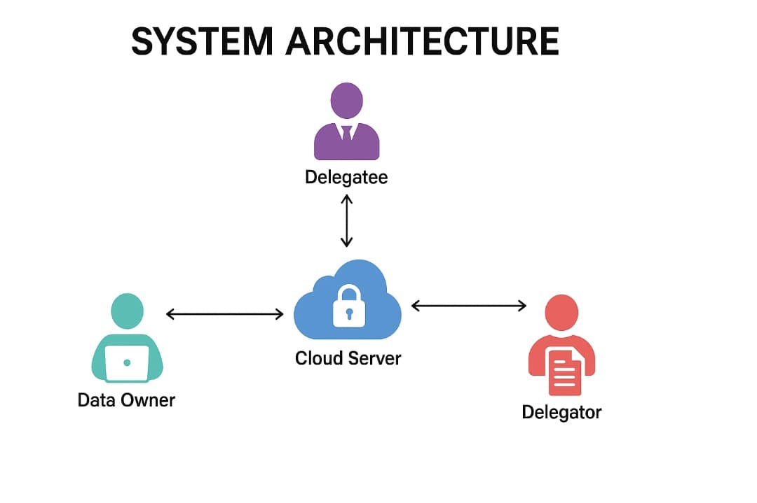
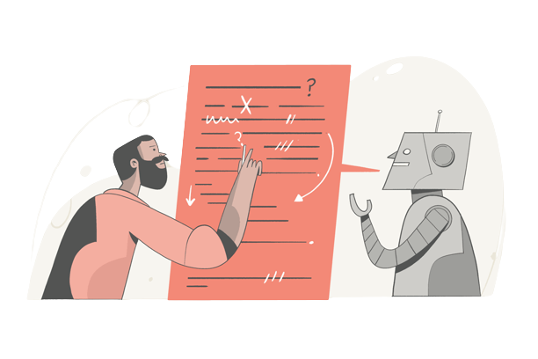
Content Generation Chatbots
Image Generation Chatbots
Code Generation Chatbots
Art Generative Chatbots
Agenda
Types of AI Chatbots
Music Generation Chatbots
Video Generation Chatbots
System Architecture
Components:
- Data Owner
- Delegator
- Delegatee
- Cloud Server
Each has distinct roles in uploading, sharing, and authorizing encrypted data.
System enables secure, searchable sharing.
Prompt Engineering
-An Art of communication with AI Tools
Challenges and Limitations
A Case Study
Ethical Considerations
Conclusion
And many more chatbots….
They can be used efficient by prompt engineers..

Slide 8
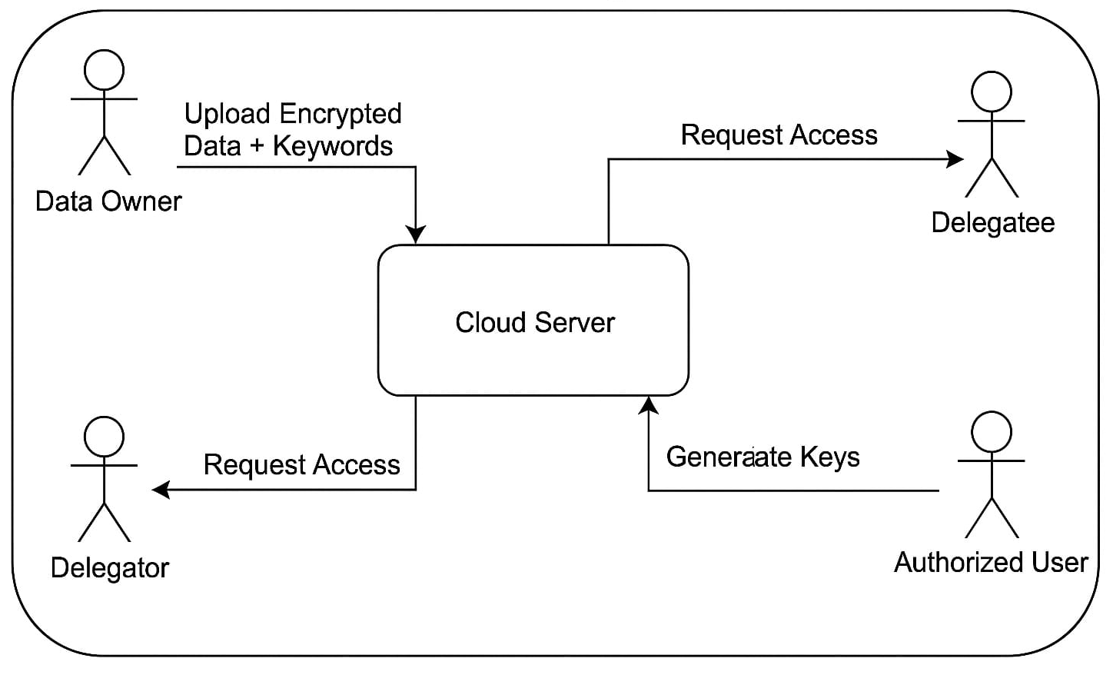
Currently there are less than 1 lakh Prompt engineers.
Prompt Engineering
-An Art of communication with AI Tools
By 2030 world need 1 Billion Prompt Engineers.
Data flow Diagram
Trying to the get efficient out from the AI Tool / AI chatbot.
A Case Study
Ethical Considerations
Conclusion
Designing queries to get perfect AI responses.

Slide 9
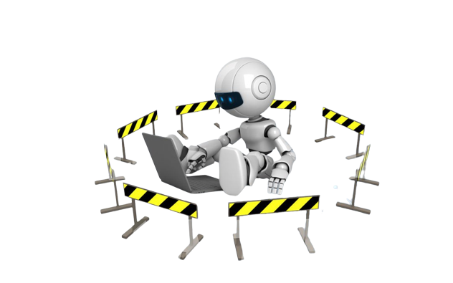
Use case Diagrams
Chatbots available on Internet
Challenges and Limitations
Use Case Diagram: Shows actor interactions with the system.
Class Diagram: Describes system classes and relationships.
Sequence Diagram: Depicts object interactions over time.
Useful for understanding system design.
SlidesAI: Generate PPTs
Only prompt Engineers can communicate most Efficiently.
Midjourney: Generates art
AI chatbots often lack emotional intelligence.
Replit: Generate codes
A Case Study
Remove.bg: Remove background in images
Soundraw: Generates music
Ethical Considerations
Chatbots require continuous monitoring, maintenance, and updates.
Conclusion
Constructing your thought is a way AI understands.
Wordtune: Summarizes the notes
Data flow Diagram

Slide 10
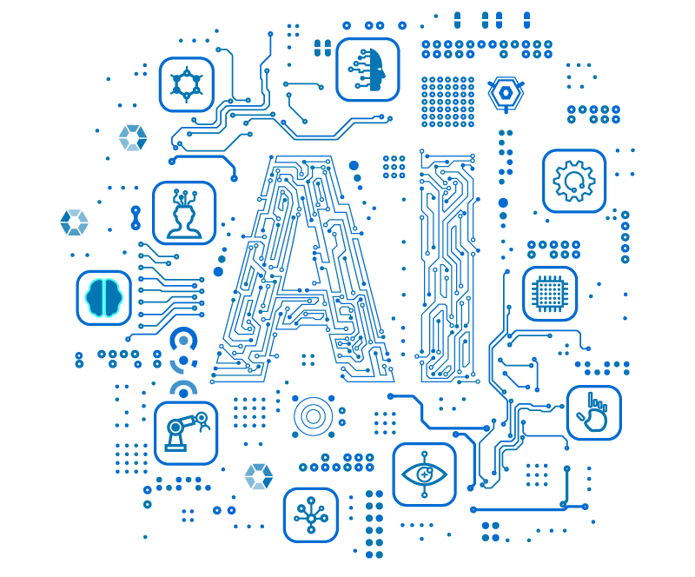
A Case Study
Implementation Modules
Data Owner: Uploads encrypted patient data.
Delegator: Requests access and adds reports.
Cloud Server: Manages permissions and shares reports.
Delegatee: Handles key generation and authorization
Conclusion
AI chatbots transform industries & improve accessibility,.
That New York lawyer faces court hearing over AI.
A lawyer in New York used ChatGPT for legal research.
AI tool leads to lawyer's court.
New York attorney's AI research troubles.
AI chatbots transform industries & improve accessibility.
Human emotions + AI creativity = Marvelous output.
AI chatbots mustn't stifle human creativity and innovation

Slide 11

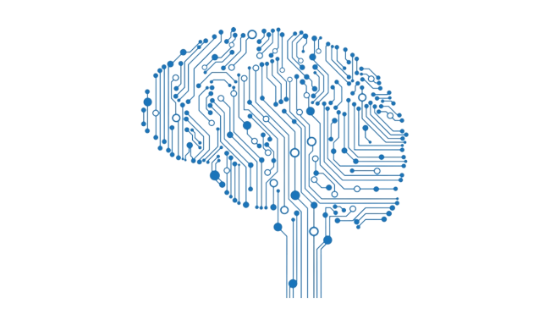
Ethical Considerations
Advantages
Chatbots must disclose AI nature to users.
Ethical Considerations
Encrypted data can be searched without decryption.
Secure and efficient data sharing.
Supports keyword update without PKG.
Data owner has full access control.
Chatbots prioritize safety; avoid giving dangerous advice.
Chatbots should explain it’s operations to build user trust.
Crucial: Protect user data from breaches & unauthorized access.
Prioritize user emotional well-being, offer support when needed.

Slide 12
Conclusion
AI chatbots transform industries & improve accessibility,.
Proposed CPAB-KSDS enables secure, searchable cloud storage.
Efficient in performance and practical in real-world scenarios.
Solves issues in traditional ABE systems.
Opens future scope for oracle-free schemes and advanced keyword search.

Slide 13
Conclusion
AI chatbots transform industries & improve accessibility,.
AI chatbots transform industries & improve accessibility.
Human emotions + AI creativity = Marvelous output.
AI chatbots mustn't stifle human creativity and innovation
THANK YOU

